Slide 1


CO458 – XML XSL in greater depth

Slide 2
Module Schedule
Wk. | Lecture/subject area(s) | Practical | Reading (McGrath, 2007; Moseley, 2007)
1 | Introduction to XML | XML exercises | Mosely Ch 8.
2 | XSL, XSLT – quick start | XSL and XSLT exercises | Mosely Ch 9.
3 | Web services, RSS, Blogs | Continue ‘quick start’ exercises | Mosely Ch 10.
4 | XML documents – 1 | Designing and writing XML documents | McGrath Ch 1.
5 | XML documents – 2 | Designing and writing XML documents | McGrath Ch 1.
6 | XSD schemas –1 | Designing schemas and schema validation | McGrath Ch 3.
7 | XSD schemas – 2 | Designing schemas and schema validation | McGrath Ch 3.
8 | XSD schema restriction | Imposing fine restriction controls | McGrath Ch 4.
9 | XML namespaces | Using namespaces in XML | McGrath Ch 5.
10 | XSL stylesheets – 1 | Designing and applying stylesheets | McGrath Ch 6.
11 | XSL stylesheets – 2 | Designing and applying stylesheets | McGrath Ch 6.
12 | XPath expressions – 1 | Writing and using XPath for advanced element selection | McGrath Ch 7.
13 | XPath expressions – 2 | Writing and using XPath for advanced element selection | McGrath Ch 7.
14 | XPath expressions – 2 | Writing and using XPath for advanced element selection | McGrath Ch 7.

Slide 3
Two Weeks Ago…
More advanced XSD schema for restricting
Numeric content
Date content
Creating custom data types
Restricting by ‘range’
Restricting string length
Restricting digit length
Pattern (RegEx) restriction
Enumerating allowable content

Slide 4
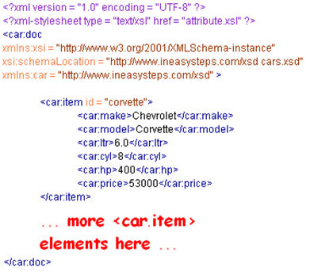
XSL Introduction
eXtensible Stylesheet Language (XSL)/documents:
An XML language to transform and XML document into other documents
Transformations may be into another XML document or into HTML
May be created in any text editor
Begin with standard XML identifier
<?xml version=“1.0” encoding=“UTF-8”?>
Followed by root “stylesheet” element, version and namespace
<xsl:stylesheet version = "1.0" xmlns:xsl = "http://www.w3.org/1999/XSL/Transform"
xmlns:c = "http://www.ineasysteps.com/xsd" >
Optional element to define output
<xsl:output method = "html" encoding = "UTF-8" />
Working example of XML used to demonstrate styesheets (McGrath, 2007)

Slide 5
XSL Introduction
eXtensible Stylesheet Language (XSL)/documents:
An XML language to transform and XML document into other documents
Transformations may be into another XML document or into HTML
May be created in any text editor
Begin with standard XML identifier
<?xml version=“1.0” encoding=“UTF-8”?>
Followed by root “stylesheet” element, version and namespace
<xsl:stylesheet version = "1.0" xmlns:xsl = "http://www.w3.org/1999/XSL/Transform"
xmlns:c = "http://www.ineasysteps.com/xsd" >
Optional element to define output
<xsl:output method = "html" encoding = "UTF-8" />
Working example of XML used to demonstrate styesheets (McGrath, 2007)

Slide 6
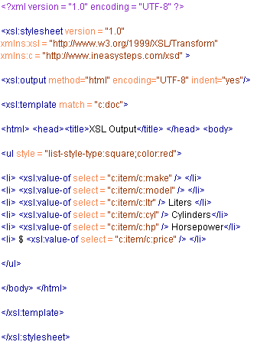
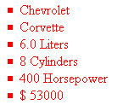
XSL – selecting element values
XSL stylesheet rules expressed as “templates”
<xsl:templates have a “match” attribute that specifies where the rule should be applied
“match” can associate the template with any element (the entire document=root, child elements, text, HTML tag, inline CSS)
XML data values may also be extracted using <xsl:value-of and “select” to specify the XML element location for the value
Transformation =

Slide 7
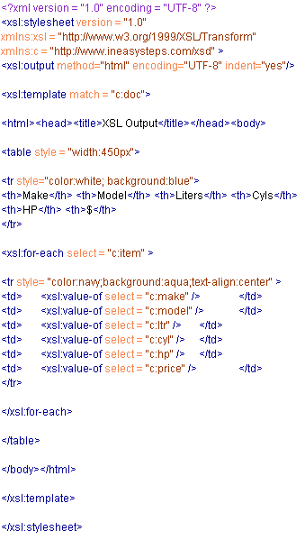

XSL – selecting each element
XSL has an <xsl:for-each> element for iterating through selected elements
Great for tables … !
Just need to nest <xsl:value-of> in <xsl:for-each> elements
This is analgous to iteration in programming
Transformation =

Slide 8
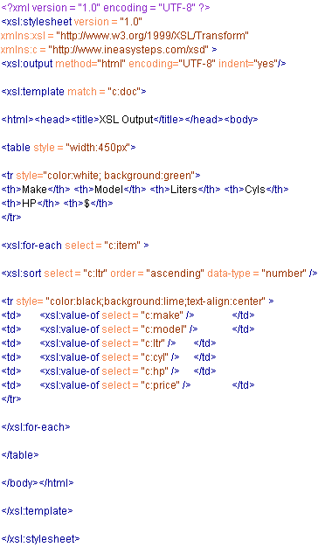
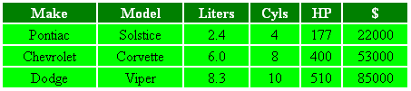
XSL – sorting selected elements
Also using XSL <xsl:for-each> …
We may also <xsl:sort> elements
The default is “ascending” but we can use an “order” attribute to specify “descending”
Transformation =

Slide 9
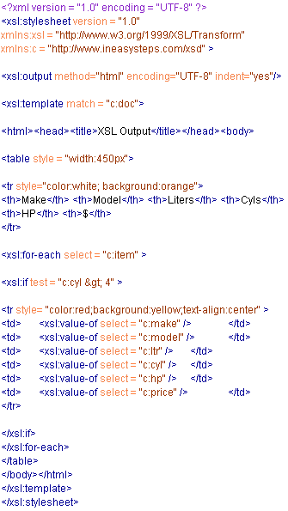

XSL – selecting by conditions (if)
Also using XSL <xsl:for-each> …
We may also apply <xsl:if > tests
These require a “test” attribute
Examples of test operators include: equals (=) ; not equal (!=); less than (&lt); greater than (&gt);
This is analgous to an ‘if’ statement in programming
Transformation =

Slide 10
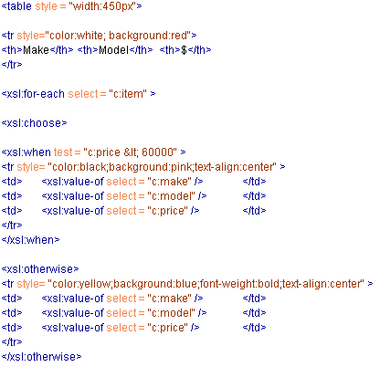
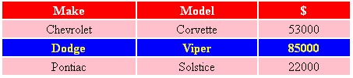
XSL – choosing alternatives (if-else)
Also using XSL <xsl:for-each> …
We may also apply a choice of rules with <xsl:choose> tests
The key elements involved are these …
How does this work?
Transformation =

Slide 11
Also … & summarising
Can also apply multiple templates and create string pointers (e.g. to image files) using a “concat” attribute (see McGrath, 2007)
Summarising
XSL is for document transformation
XSL stylesheets are XML documents and therefore follow the same rules
The root element of an XSL stylesheet is <xsl:stylesheet>
XSL stylesheet rules are defined by <xsl:template> and associated to elements with a “match” attribute
<xsl: value of> and the select attribute allow for selection of XML data
<xsl:for each> allows for iteration and may be used to form more complex selections and ‘sorts’ in combination with <xsl:sort>, <xsl:if>, <xsl:choose>, <xsl:when> and <xsl:otherwise>

Slide 12
Key points 1 - XSL
XSLT = XSL Transformations (into other formats, e.g. PDF and XHTML)
XSL is to XML as CSS is to HTML
XSL includes XSLT, XPath (the means for navigating XML data trees) and XSL-FO (Formatting Objects)

Slide 13
Key points 2 - Resources
XSLT requires
an *.xsl stylesheet with one or other synonymous declaration
<xsl:stylesheet version="1.0" xmlns:xsl="http://www.w3.org/1999/XSL/Transform">
or:
<xsl:transform version="1.0" xmlns:xsl="http://www.w3.org/1999/XSL/Transform">
an XML document to transform with a link to the *.xsl
<?xml-stylesheet type="text/xsl" href="cdcatalog.xsl"?>

Slide 14
Key points 3 – template ‘match’
XSL <template>
<xsl:template match="/"> where the value of the match attribute is the XPath expression.
Having ‘matched’ a template, it is often necessary to ‘apply’ further templates for nested items (next slide)

Slide 15
Key points 4 – template ‘apply’
Syntax example for <xsl:apply-templates> ...
<xsl:template match="cd">
<p>
<xsl:apply-templates select="title"/>
<xsl:apply-templates select="artist"/>
</p>
</xsl:template>
<xsl:template match="title">
Title: <span style="color:#ff0000">
<xsl:value-of select="."/></span>
<br />
</xsl:template>

Slide 16
Key points 5 – processing items
<xsl:value-of> to extract data
e.g. <td><xsl:value-of select="catalog/cd/title"/></td> where the value of the select attribute is the XPath expression.
<xsl:for-each> to iterate
e.g. <xsl:for-each select="catalog/cd"> where the value of the select attribute is the XPath expression.
<xsl:sort > for alphanumeric sorting
e.g. <xsl:sort select="artist"/> where the value of the select attribute is the XPath expression.

Slide 17
Key points 5 – making choices
<xsl: if> conditional test
e.g. <xsl:if test="price &gt; 10">
<xsl:choose> … syntax ...
<xsl:choose>
<xsl:when test="expression">
... some output ...
</xsl:when>
<xsl:otherwise>
... some output ....
</xsl:otherwise>
</xsl:choose>

Slide 18
Practical

Slide 19
Practice using the examples provided (use cars.xml and recreate the examples in slide numbers 5-9
How might the above techniques be applied to differentiating between ‘resume’ and full chronological CVs?

